Slide 1

Unconscious Bias
Conference of Colleges Diversity Fund Project on special dietary requirements of BAME and observant religious students
The Listening Brain, Source: The Wellcome Institute

Slide 2
Ethical eating
Module 1

Slide 3

Your Name Here
Your College Here

Slide 4

INTRODUCTIONS
Your name and what you do
How long you have done it?
Why are you here?
Why do you want to be a trainer on this subject?
Notes:
4

Slide 5


Domestics
Respectful use of phones please
Emergency evacuation
Toilets
Refreshments

Slide 6
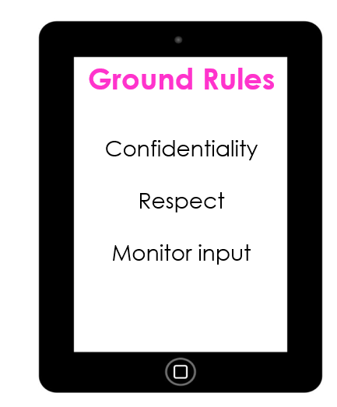

Slide 7
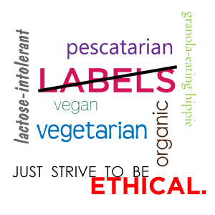
Ethical Eating – An Overview
What is meant by ethical eating?
Why we should take it seriously?
How it will effect you in the workplace

Slide 8
is it Vegan?
Ice-Breaker

Slide 9
Accidentally Vegan
Many people have the mistaken belief that becoming Vegan is a bit like joining a cult.
That you have to give up everything!!!
This exercise is to look at what already exists in supermarkets.
Food items that are “Accidentally Vegan”
In pairs decide whether you think something is or isn’t vegan.

Slide 10


Guinness
Notes:
Stopped using fish bladders in it’s brewing process

Slide 11
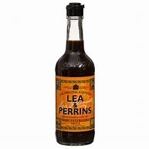

Lea & Perrins
Notes:
Contains Anchovies

Slide 12
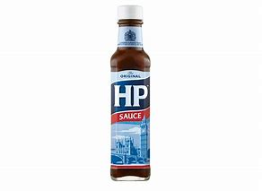
HP Sauce
Notes:
The fruity brown sauce beloved of MPs has always been vegan. As is Heinz tomato ketchup.

Slide 13
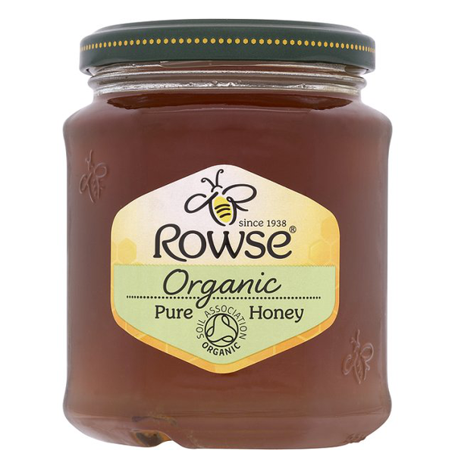


Slide 14

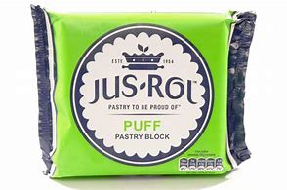

Slide 15
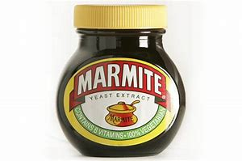
Marmite
Notes:
Love it or loathe it – it’s vegan

Slide 16
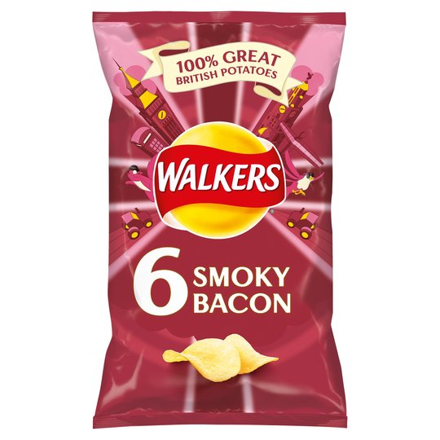
Walkers Smoky Bacon
Notes:
Never been near a pig! However, it’s flavouring contains dried milk.

Slide 17
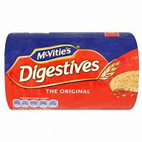
McVitie’s Digestives
Notes:
No – cursed with dried milk!

Slide 18


Slide 19



Slide 20
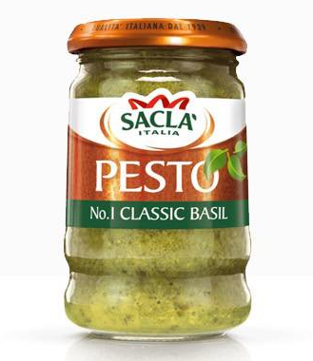

Slide 21
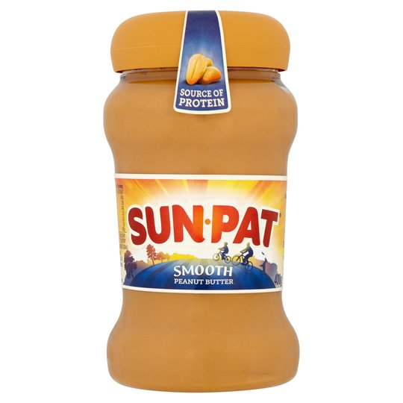


Slide 22
…and the equality act
Customer Care

Slide 23
The Equality Act and Customer Care
It is a key part of the legal framework that underpins the way the University provides its services
It sets out everyone’s right to be treated as an individual and with respect and dignity
It requires that university education services must be fair and meet the needs of everyone

Slide 24
The Equality Act 2010
Prohibits discrimination from:
Employers
Businesses and organisations which provide goods or services like banks and shops
Someone you rent or buy a property living in hall, or student letting agents
Universities, colleges and schools
Public bodies like government departments and local authorities.

Slide 25
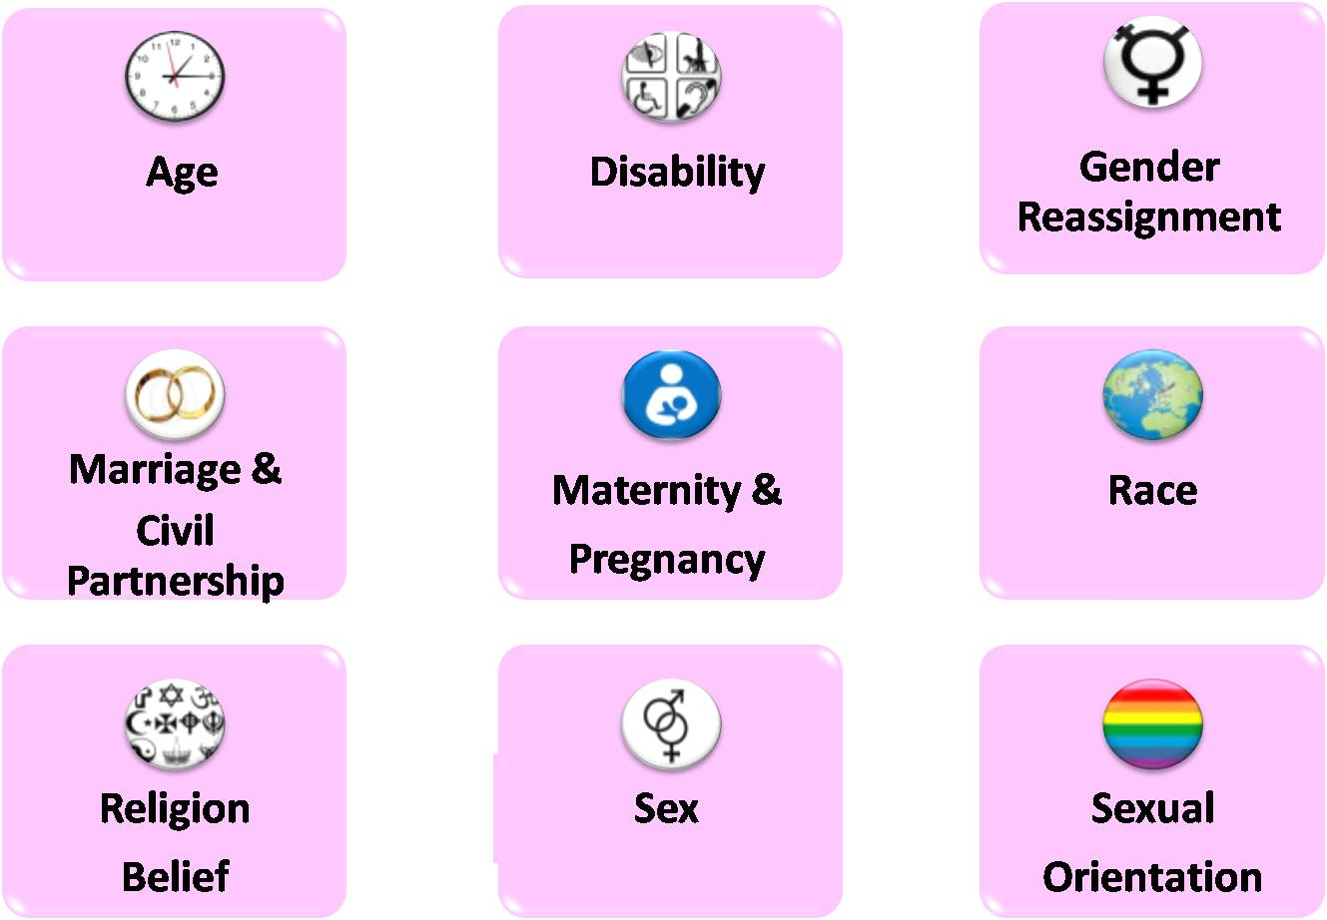
9 Protected Characteristics
The concept of “protected characteristics” brings all the existing protected grounds of discrimination into one place

Slide 26

It is covered by your Equality Policy providing for an inclusive environment, which:
'promotes equality, values diversity and maintains a working, learning and social environment in which the rights and dignity of all its staff and students are respected.'
It also provides that no student or member of staff will be treated less favourably on grounds which includes philosophical belief.

Slide 27
Types of unlawful treatment
Being treated unfairly because of one or more protected characteristics is unlawful
If you’re treated unfairly because someone thinks you belong to a group of people with a protected characteristic, this is also unlawful discrimination.

Slide 28
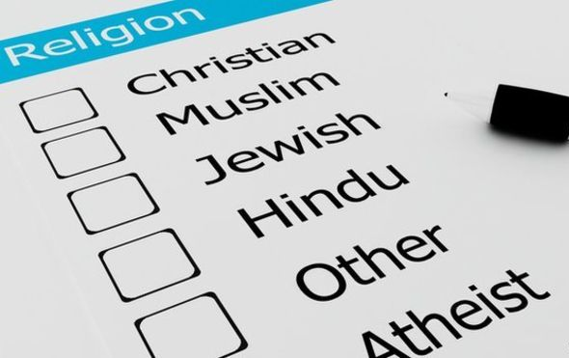
What is a religion or belief?
The definitions of religion and belief are:
religion:
any religion or reference to religion, including a reference to a lack of religion
belief:
any religious or philosophical belief or reference to belief, including a reference to a lack of belief

Slide 29
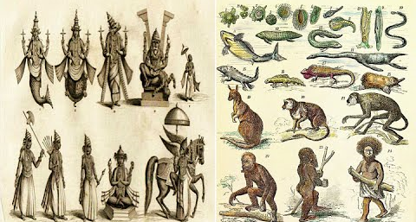
Religious and Philosophical
Being a follower of a religion does not stop you having a strong philosophical belief
You can be:
  Catholic and Vegan
  A Marxist Jew
  A Darwinian Hindu
  or a Buddhist with a Free Market Capitalist outlook

Slide 30

To come under the protection of the Equality Act
A Philosophical Belief must be:
Genuinely held
A belief and not an opinion
On a significant aspect of human life and behaviour
Have attained a level of respect and seriousness
Worthy of respect and compatible with the fundamental rights of others
Notes:
NEEDS TO BE MORE PEOPLE FOCUSSED AND LESS LEGAL

Slide 31
What Is It?
In pairs decide if the following points are:
  Lawful
  Unlawful
  Good Practice
  Bad Practice
What would you do?
Notes:
https://www.thecaterer.com/articles/497150/new-regulations-on-cooking-burgers-come-into-force
For the information about cooking burgers.

Slide 32
Who is the customer?
University of Oxford

Slide 33
Who are my customers?
Around the diagram, write the types of people you come into contact with, who you regard as your customers
YOU

Slide 34
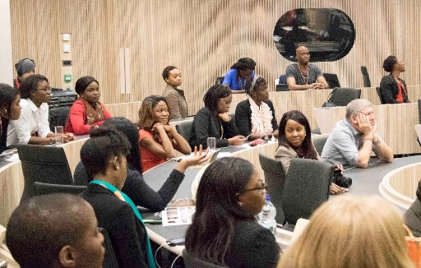
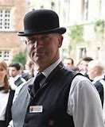
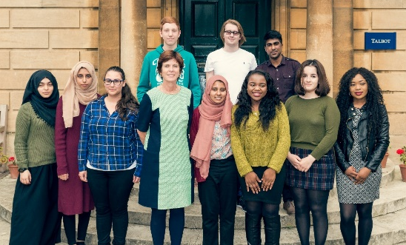
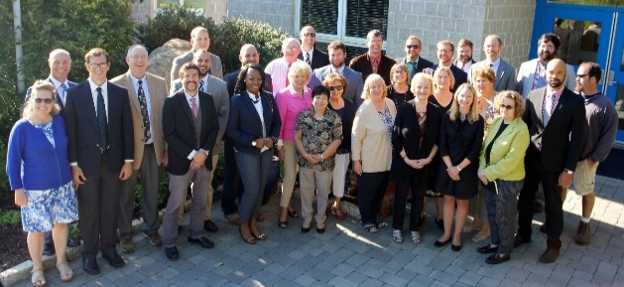
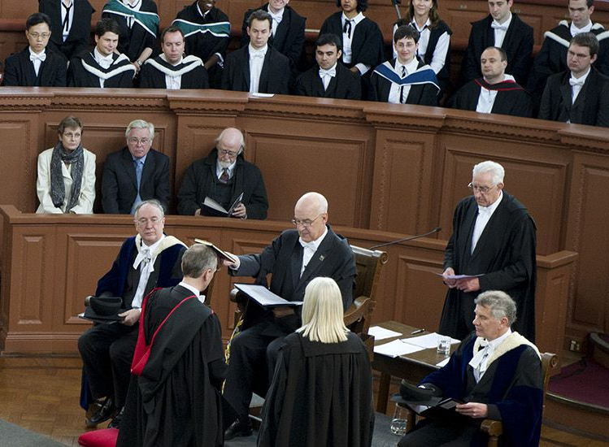
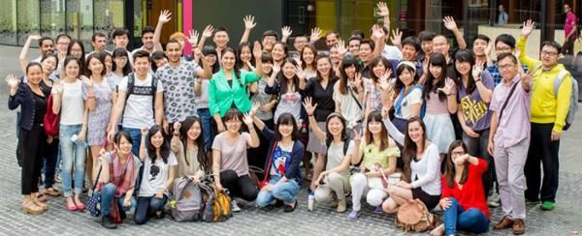
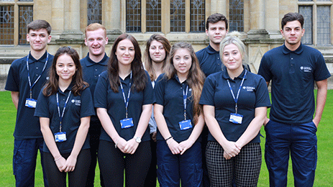
External and internal customers
Conferences
College Staff
Students
YOU
Admin Staff
Academic Staff
Language Schools
Maintenance Staff

Slide 35
Our customers include:
People who use our services
People acting on behalf of people who use our services
Staff in the University – our internal customers
Contractors working for the University – our external customers
Other stakeholders

Slide 36
What is a customer?
A customer is anyone who comes to you, or relies on you, for a service or for information
Even if you do not provide a service directly to a customer, you will be providing a service to someone who does

Slide 37
On the topic of your customers
How aware are you of how well you treat your colleagues?
Do you provide the same level of professionalism and care to all your customers?
The approaches we use with our colleagues should mirror those we use with other customers

Slide 38
Importance internal customers
Great customer service means delivering a service to everyone we come into contact with, on top of the job we’re actually employed to do
Treating your colleagues with great customer care and respect is as important as it is with other customers
“It's almost impossible to provide good external service if you and your organisation are not providing good internal service."
Benjamin Schneider, University of Maryland

Slide 39
Break
Be back in 15 minutes!

Slide 40
Eating ethically
Introduction and Explanation
Notes:
Just a quick introduction on what’s to come

Slide 41
Veganism
Catering for Students and Staff with Ethical Diets

Slide 42


What is Veganism?
Veganism is a way of living which seeks to exclude all forms of exploitation of and cruelty to animals whether:
  for food,
  clothing
  any other purpose e.g. painting and decorating
Notes:
Decorating = whether paint companies test their products on animals

Slide 43
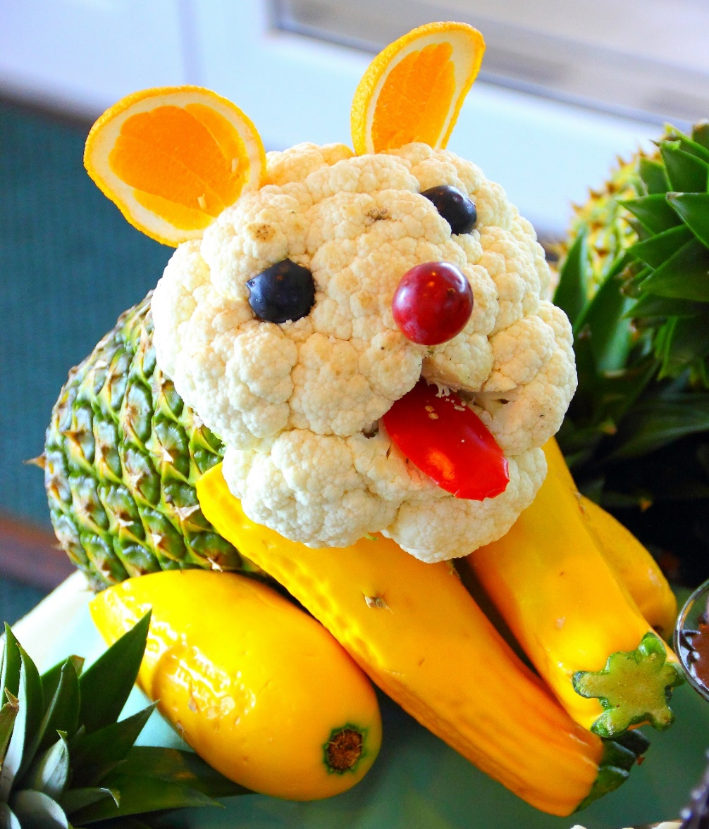
All Vegans
Have a plant-based diet
Vegans avoid eating:
  Meat
  Dairy
  Eggs
  Honey?
As well as:
  Leather
  Anything ‘Tested on Animals’

Slide 44
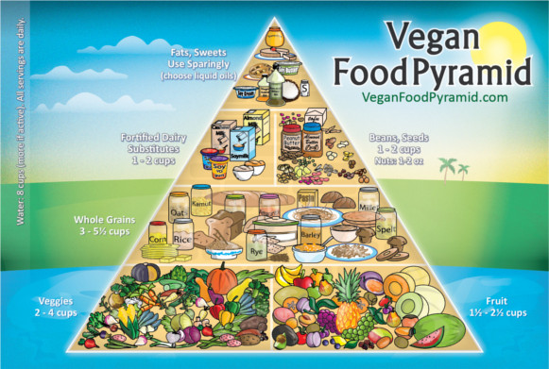
A Vegan Diet
Is richly diverse and comprises all kinds of:
  Fruits
  Vegetables
  Nuts
  Grains
  Seeds
  Beans and Pulses

Slide 45
Flexitarians
A semi-vegetarian diet
Mostly vegetarian, but either occasional meat consumption
Or, as can happen, 100% vegan until alcohol is consumed
People are edging towards a more vegetarian diet and according to the UN is a more sustainable way of living
The Flexitarian Diet
Notes:
Flexitarianism will probably be familiar for anyone who has been on a diet. Lots of good intentions. However, it is possible to make a virtue out of the tendency for most people to lapse every now and again.
It is a way for people to try and move towards vegetarianism/veganism.

Slide 46
Vegetarianism
Catering for Students and Staff with Ethical Diets

Slide 47
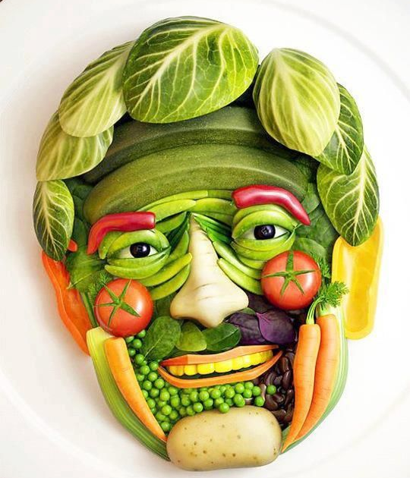
Nothing With a Face!
The term ‘vegetarian’ applies to people who choose not to eat any part of an animal:
Meat
Poultry
Fish
Shellfish

Slide 48
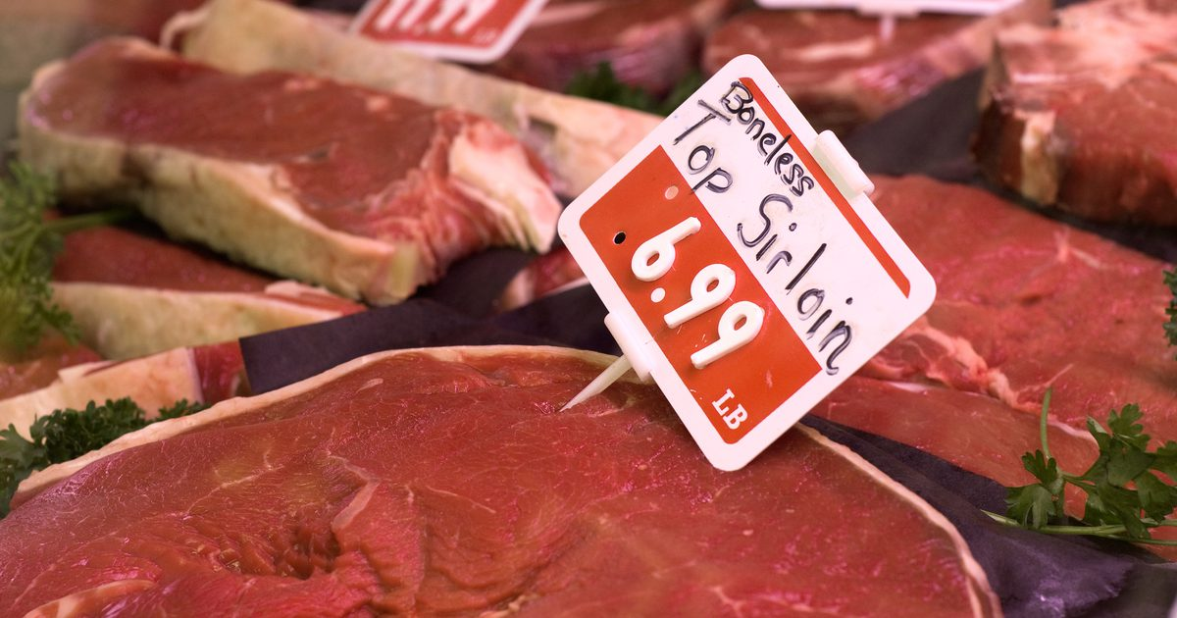
Yes, but Why?
People become vegetarians for many reasons including:
Health
Religious convictions
Concerns about:
  animal welfare
  Use of antibiotics and hormones in livestock
A desire to eat in a way that avoids excessive use of environmental resources
Not being able to afford to buy meat

Slide 49
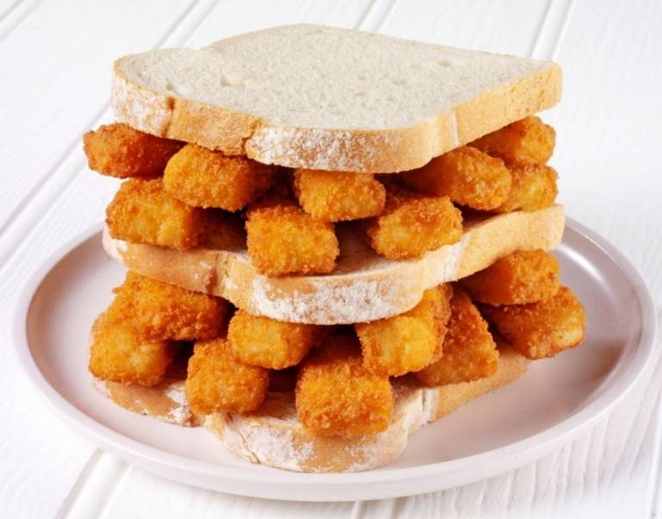
Pescatarians
Is the practice of not eating meat, but of eating fish
Often included with vegetarian
Fish production seen as having a lower carbon footprint
Notes:
The great and glorious fishfinger sandwich

Slide 50

Vegetarian diets may be:
Lacto-Ovo
Includes dairy and eggs
Lacto
Includes dairy (no eggs)
Ovo
Includes eggs (no dairy)
Cultural Vegetarians
Eat meat sparingly
Eat fish
Notes:
One out of three vegetarians eat meat when drunk!4
Cultural vegetarians – for example if you live on an island you may well have grown-up on a mostly vegetarian diet supplemented by fish and meat when available.

Slide 51
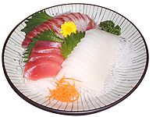
Other types of eating?
Fruitarianism
Permit only fruit, nuts, seeds, and other plant matter that can be gathered without harming the plant
Macrobiotic
A pescatarian vegetarian diet system that has grown out of Zen Buddhism
Raw Foodism
Practice of eating only or mostly uncooked and unprocessed food. Not necessarily vegetarian!
Notes:
Fruitarians – a subset of vegans. Eat primarily fruits. With some nuts and seeds.
Macrobiotic diet has grown out of Zen Buddhism. It attempts to balance the yin and yang elements of food and cookware. Reducing the amount of animal products, eat locally grown foods that are in season and consume meals in moderation. It was popularised in the 1930’s by George Ohsawa.
The picture is of a Sashimi Dinner – raw fish or meat sliced into thin slices and eaten with soy sauce
Most Rawists are vegetarian, but the raw Palaeolithic-diet (sometimes known as the Cave Man/Woman diet) can also include either raw eggs, fish, meat .

Slide 52
The organic movement
Catering for Students and Staff with Ethical Diets

Slide 53
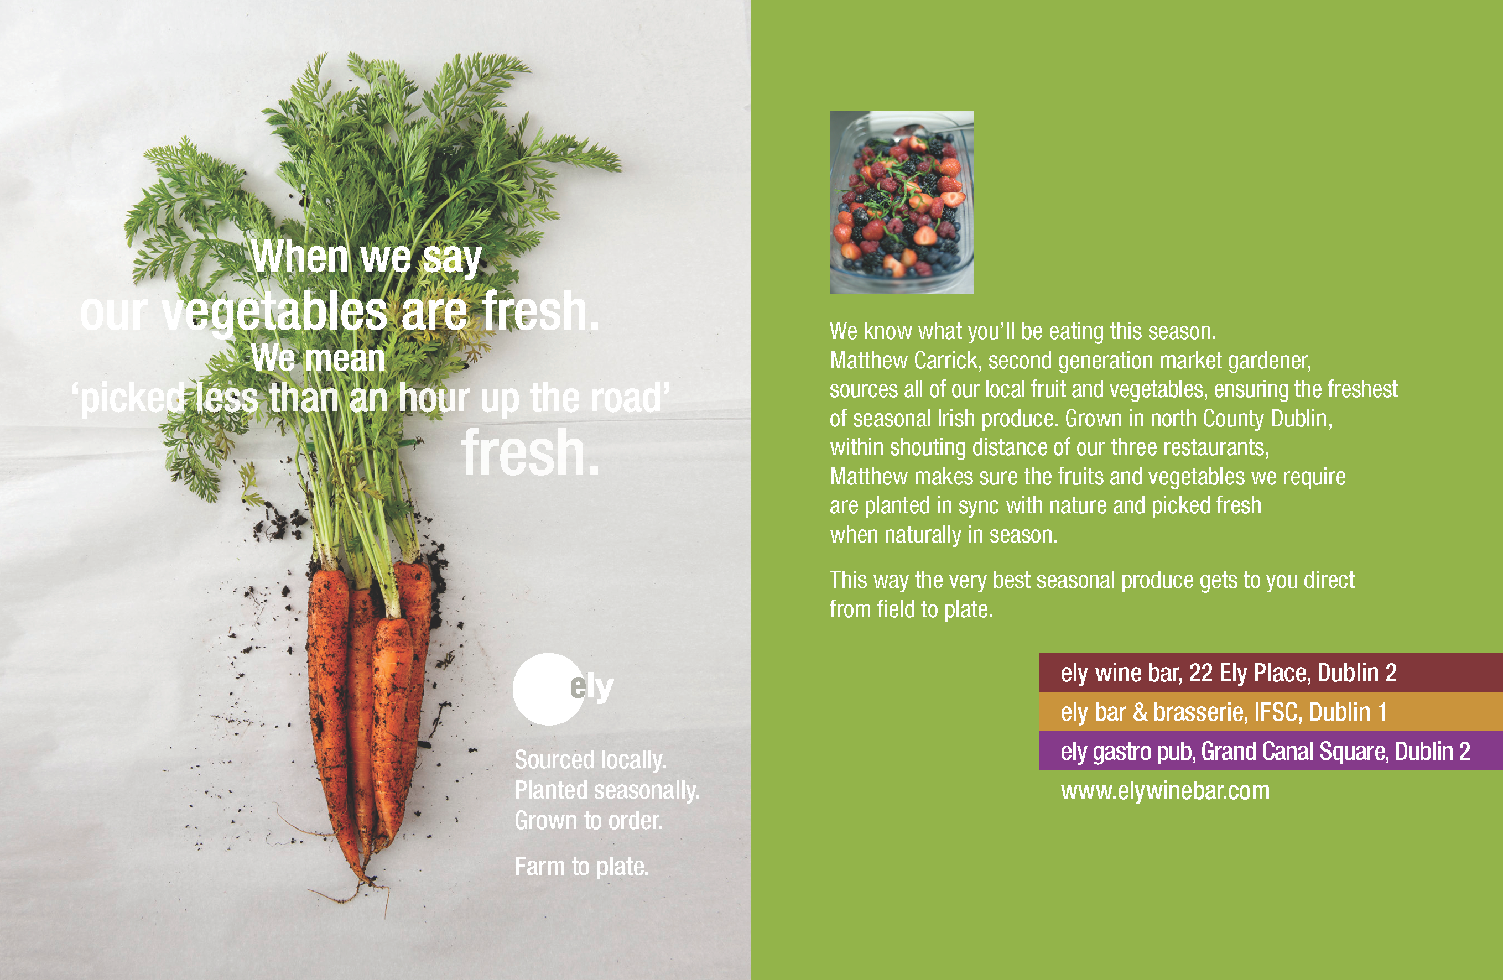
Importance of Provenance
The drive for cheaper food means that food can:
Pass through multiple channels
In different countries
Difficult to manage supply chain compliance
Traceability can be difficult

Slide 54
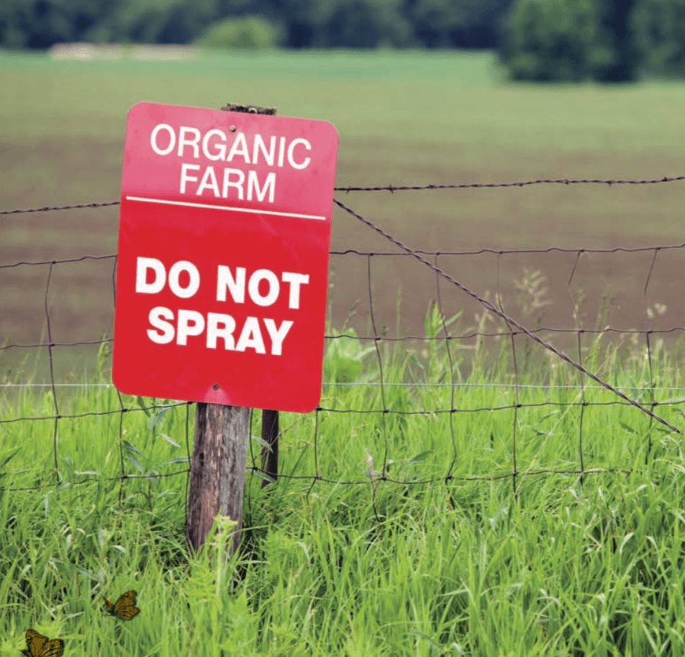
Organic Movement
Broadly refers to the organizations and individuals involved worldwide in the promotion of organic farming and other organic products.
It started in the first half of the 20th century, when modern large-scale agricultural practices began to appear

Slide 55
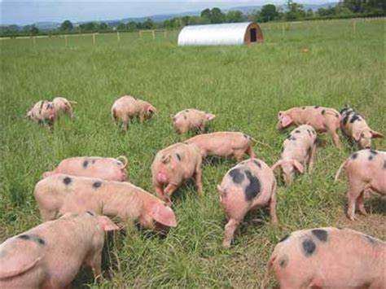
Aims of Organic Farming
To maintain the long term fertility of the soil
To reduce the input cost
To effectively utilize resources
To avoid all forms of pollution caused by agricultural techniques
To provide a quality foodstuff
Notes:
Picture of organic pig farming

Slide 56
Provenance and the Organic Movement
Organic Movement Ideal:
Buy local
Buy regionally
Buy nationally
Buy in season
Reduce carbon foot print
Organic Movement Actual:
Much organic food imported
This means food produced out of season
Big carbon footprint as more organic food imported
10 to 40% more expensive than non-organic

Slide 57
Entomophagy
Catering for Students and Staff with Ethical Diets

Slide 58
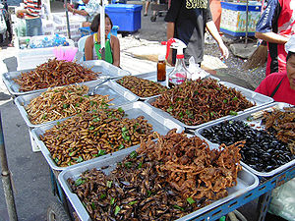
Saving the best till last
Entomophagy
The practice of eating insects
A cheap and sustainable source of protein
Not common in Europe and North America
May be the way forward
Yuck factor!
Notes:
Basically, eating insects.
Very high in protein.
Big yuck factor –
People used to feel the same about raw fish.
Ground-up insect protein is being trialled as a protein replacement for meat in dog food.
IKEA are investing in companies that are looking to produce a high-quality protein ingredient.
So, you are unlikely to sit down to a meal of stir-fried mealworms, but you might at some point find that insect protein is being introduced into processed ready meals. Hopefully clearly labelled.

Slide 59
Shopping bag of delights
Catering for Students and Staff with Ethical Diets

Slide 60
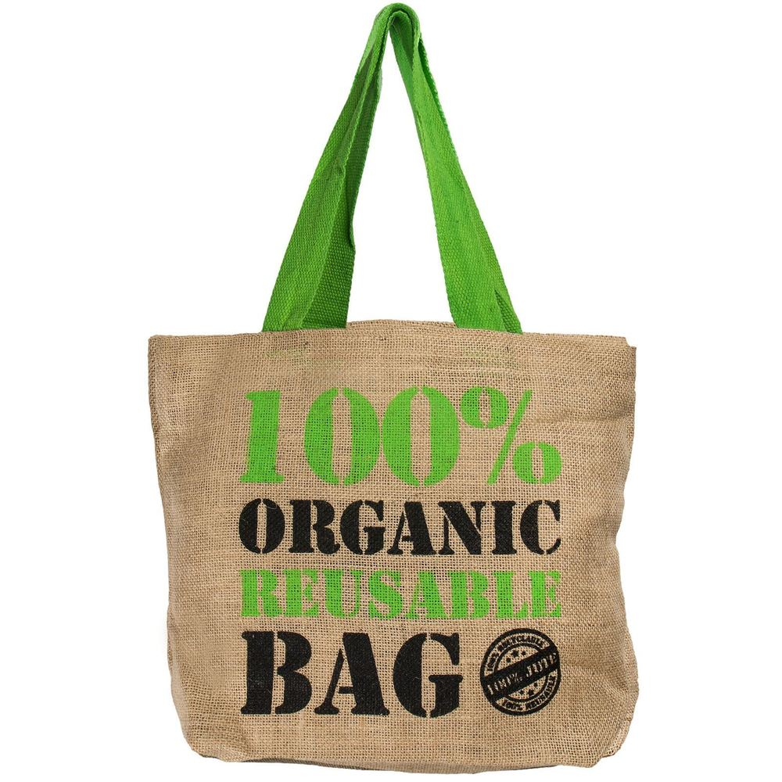
Shopping Bag of Delights
This is an exercise to see what you have remembered from earlier in the session
Notes:
The next section is case studies.

Slide 61
Nutrition
What does it mean to you?

Slide 62
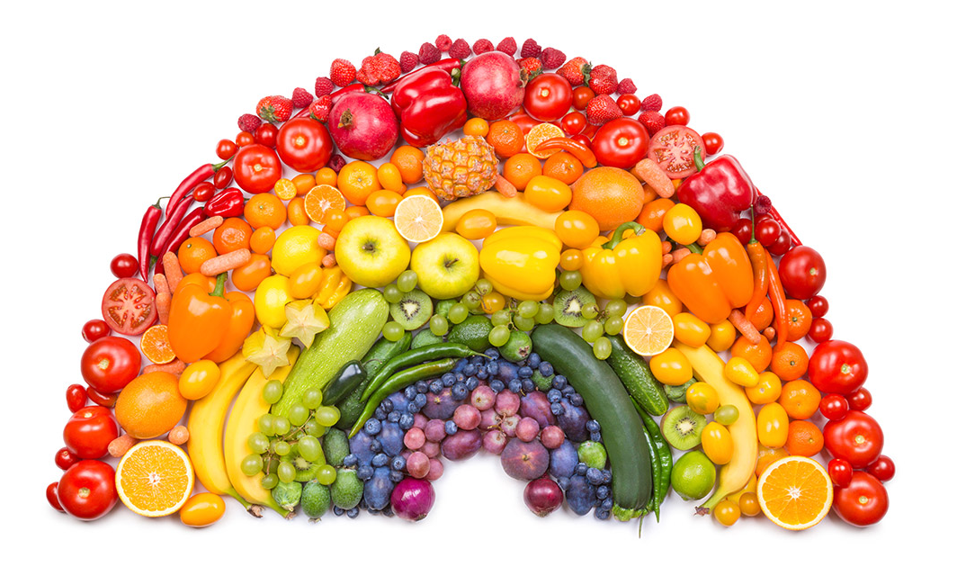
Taking In and Utilisation
Nutrition:
Taking in
Utilisation
For the:
Growth
Repair
Maintenance of the body!

Slide 63
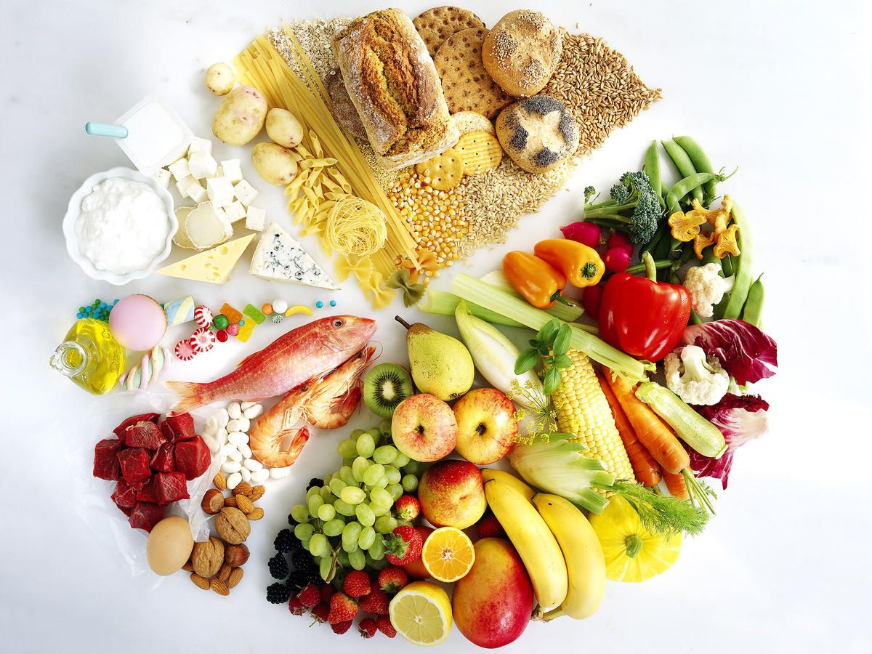
6 Categories of nutrients
What your body needs to acquire from food:
Protein
Carbohydrates
Fat
Fibre
Vitamins & Minerals
Water

Slide 64
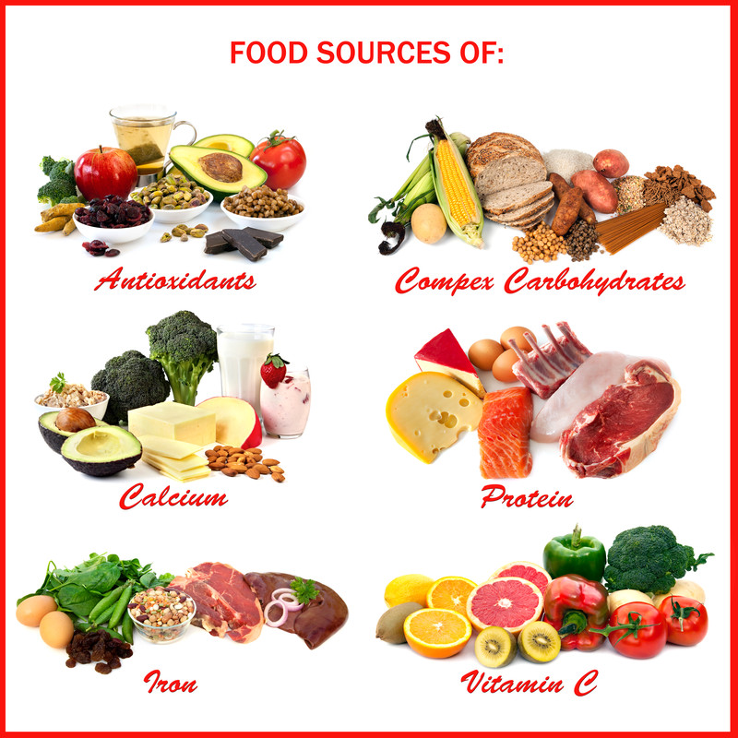
Nutrient Distribution & Intake
Importance of Nutrients (Food Groups):
Grains
Vegetables
Fruits
Dairy
Protein

Slide 65
Nutrients from Grains
Good For:
Regulates absorption of digested fats
Lower Cholesterol
Energy
Mood and Memory
Skin and Hair
Immune System
Red Blood Cells
Pregnancy
Fibre
B Vitamins

Slide 66
Nutrients from Vegetables
Good for:
Building Muscles
Nerve transmissions
Regulates absorption of digested fats
Lowers cholesterol
Development of Healthy foetus
Keeps eyes working
Growth & Development
Healing of wounds
Potassium
Fibre
Folic Acid
Vitamin A
Vitamin C

Slide 67
Nutrients from Fruit
Good for:
Building Muscles
Nerve transmission
Reduces the absorption of digested fats
Lowers cholesterol
Growth & Development
Healing of wounds
Potassium
Fibre
Vitamin C
Folic Acid

Slide 68
Nutrients from Dairy
Good for:
Healthy Bones & Teeth
Regulates Muscles and Hormones
Builds Muscles
Nerve transmissions
Strong immune system
Blood pressure
Mental health
Healthy Skin and Hair
Calcium
Potassium
Vitamin D
Fat

Slide 69
Nutrients from Protein
Good for:
Strong muscles
Healthy blood
Pregnancy and lactation
Mental health
Healthy immune system
Nerve & muscle function
B Vitamins
Vitamin E
Iron
Zinc
Magnesium

Slide 70
Nutrients from Oils and Fats
Good for:
Healthy cell production
Support the health of your eyes
Transmission of nerve signals
Regulating the body’s systems
Healthy skin
Essential Fatty Acids
Vitamin E

Slide 71
Adapting and changing
Case Studies

Slide 72
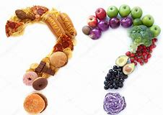
Cases Studies
Here are six students who will get to know in these sessions
In this session we would like you to adapt and change the meals so that they are nutritionally balanced and appropriate to their ethical choices
Notes:
The next section is case studies.

Slide 73
Thank You
Final Questions
Notes:
Any feedback from the course will be included in a tweaked version on the USB Stick you will get next week.

